Slide 1
Note: most of the in-depth explanation on what we did are in the project (.ipnyb) file itself, this powerpoint file is just a summary on what we did :-)

Slide 2


CHOCKALINGAM KASI
GOH TING QI
JARYL CHAN JIA LE
SITI NAZHURA BTE MUHAMAD ANUAR
FEP2T03
Notes:
-short introduction of all the group members
- maybe a description of each people’s roles

Slide 3
CONTENTS
01
02
03
OUR DATASET
EXPLORATORY DATA ANALYSIS
PREPARING THE DATASET
04
05
06
PREDICTION USING LINEAR REGRESSION
PREDICTION USING OTHER TECHNIQUES
TIME SERIES ANALYSIS
A closer look at the Airbnb dataset
How we came up with our problem statements
How we cleaned our data
Using Time Series forecasting to predict future prices
Determining the price of an AirBnB unit using linear regression
Determining the price of an AirBnB unit using other techniques
Notes:
-just a quick run through
- talk about what would be said for each point briefly

Slide 4
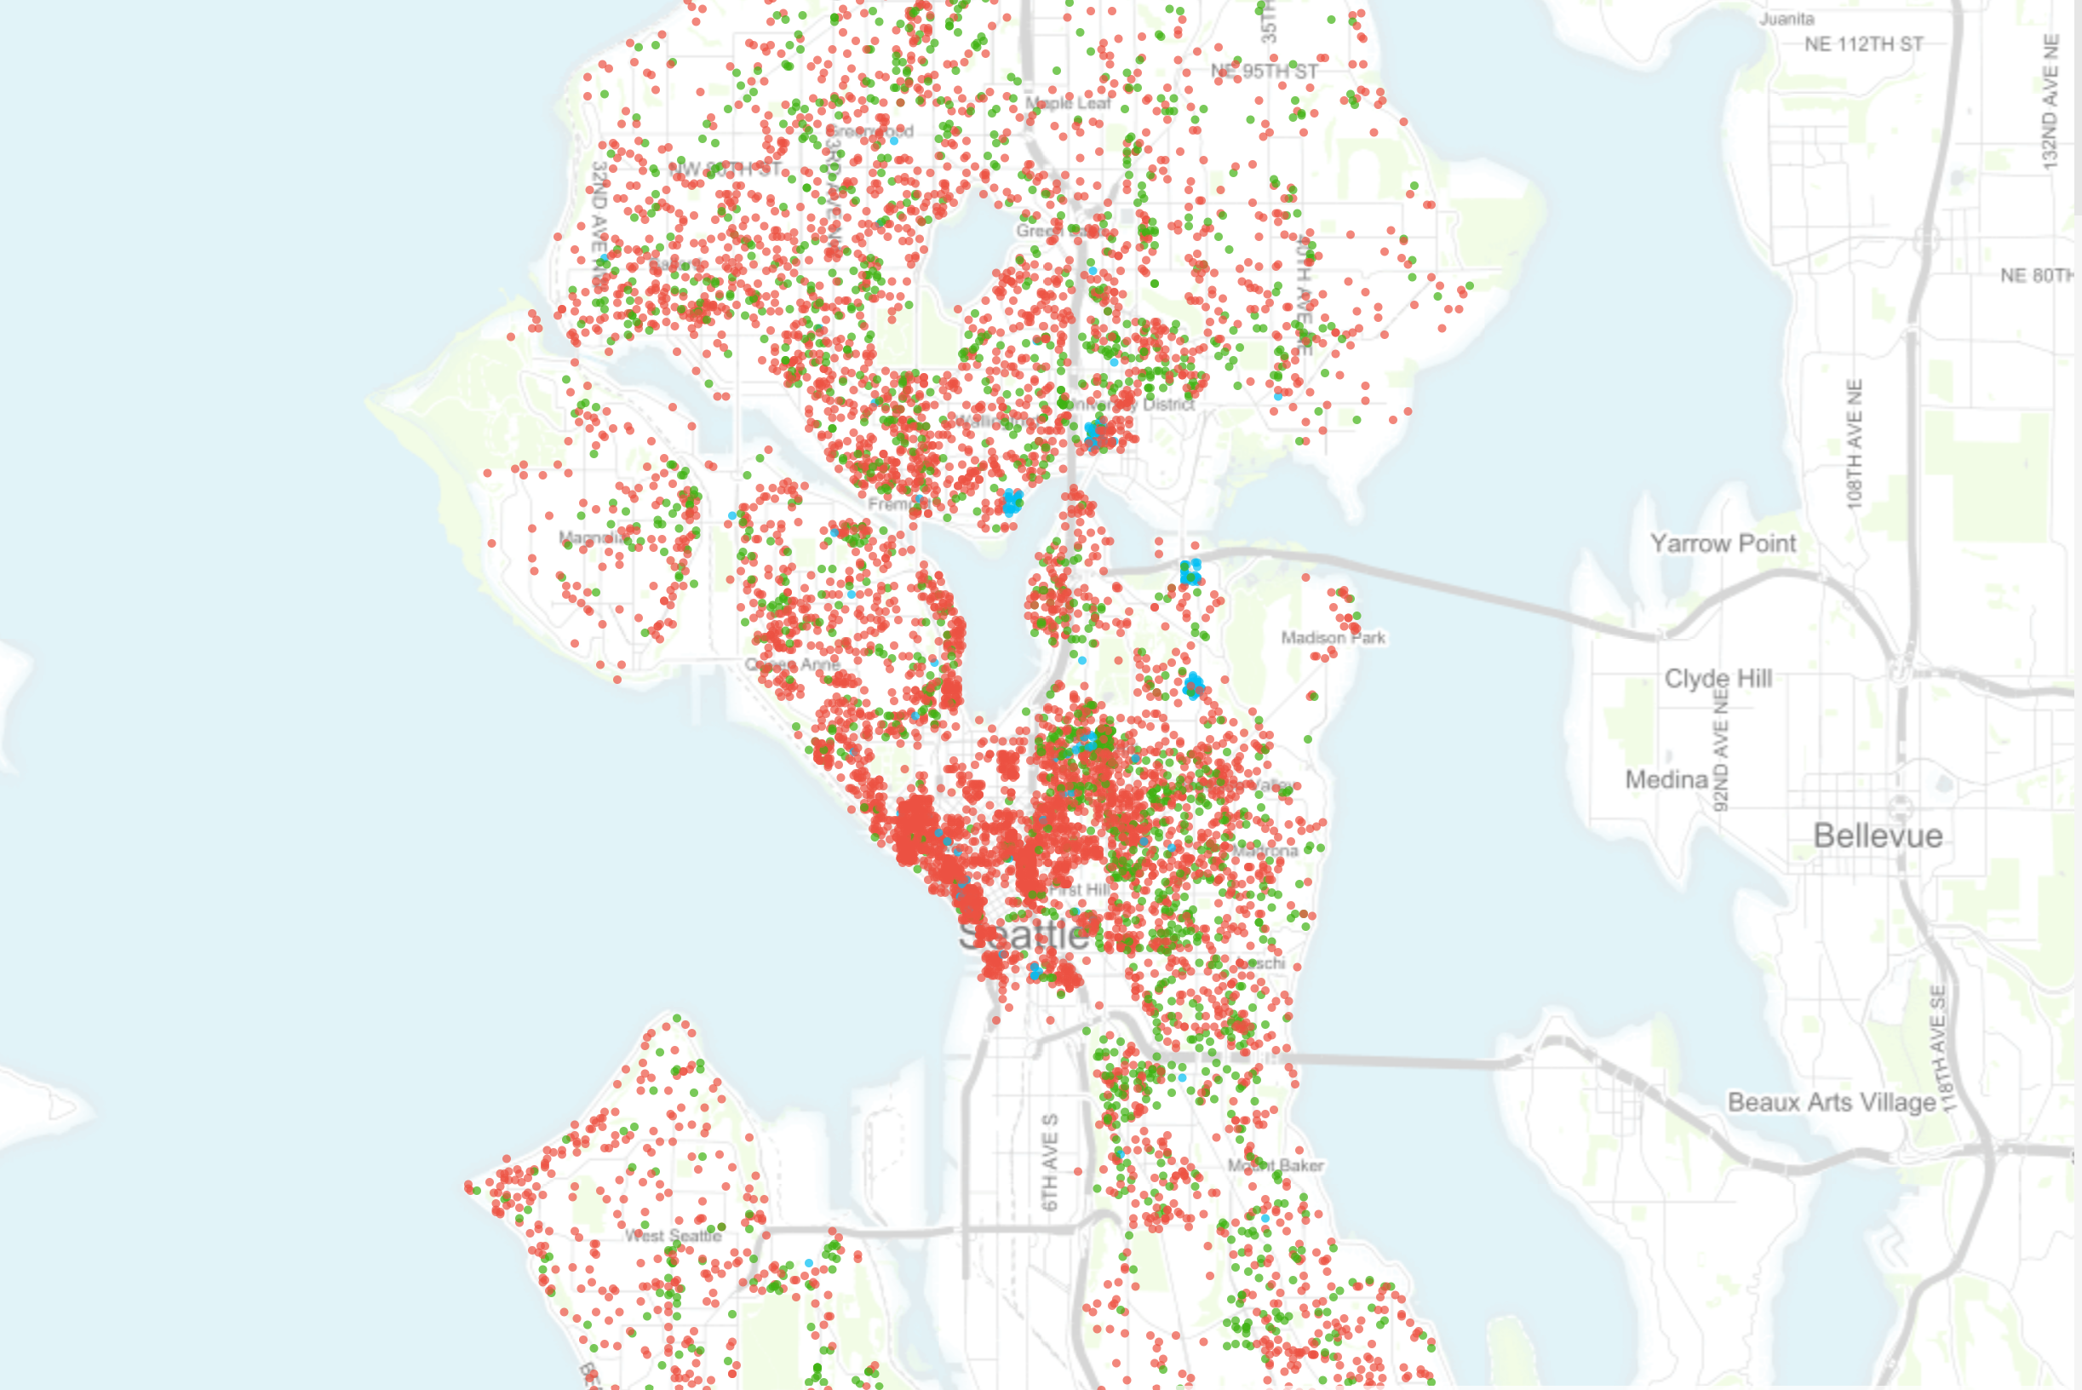
01
OUR DATASET

Slide 5
SEATTLE AIRBNB OPEN DATA
Since 2008, guests and hosts have used Airbnb to travel in a more unique, personalized way
This dataset describes the listing activity of homestays in Seattle, WA
The following Airbnb activity is included in this Seattle dataset:
Listings, including full descriptions and average review score
Reviews, including unique id for each reviewer and detailed comments
Calendar, including listing id and the price and availability for that day
Notes:
-just follow the points

Slide 6
OUR BUSINESS PROBLEM:
Helping hosts maximise revenue by using machine learning solutions
Notes:
Ting qi, you can say ‘Predicting the price of an airbnb listing using various techniques to find out which technique will produce the best reseult in the prediction’ etc etc something like that sorry my engrand no good

Slide 7

02
EXPLORATORY DATA
ANALYSIS

Slide 8
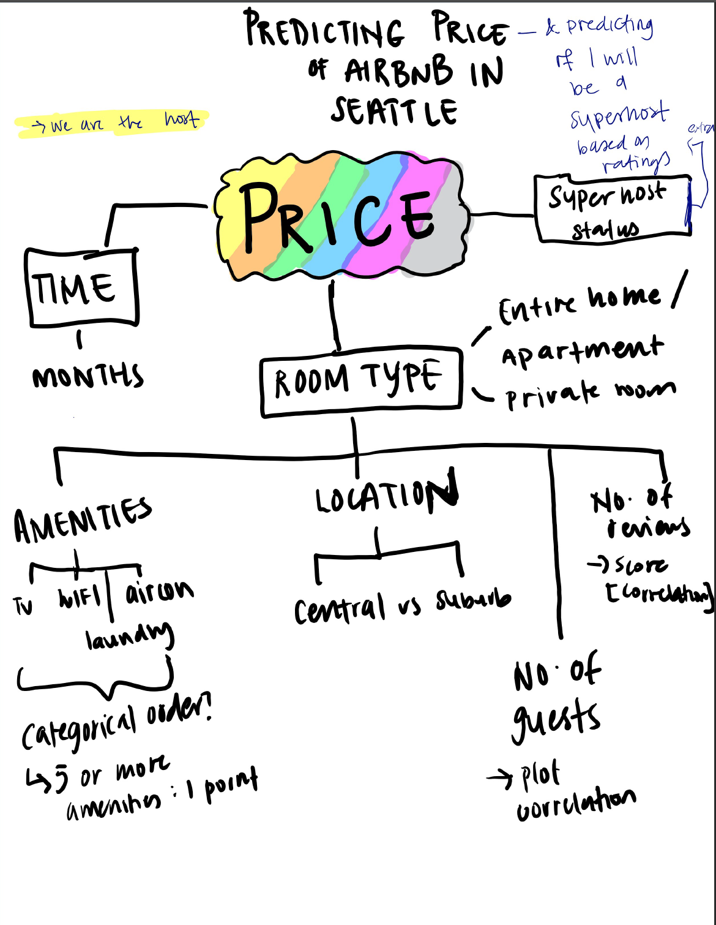
EXPLORATORY DATA ANALYSIS - OUR ASSUMPTIONS
Number of reviews and location could not be used for the regression
Review had very little correlation with price
Location uses latitude longitude- not usable
Superhost
‘T’, ‘F’ variables
Could not be used in Regression - did Classification instead
Time Series
Using past data to predict future prices of Airbnb unit
Notes:
Explain that this is what we came up with before the exploratary analysis
Explain that this assumptions were debunked

Slide 9
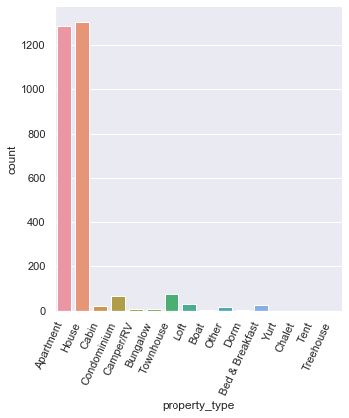
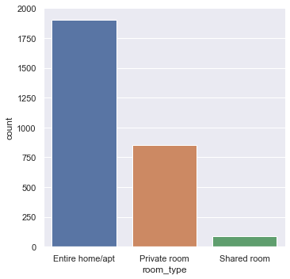
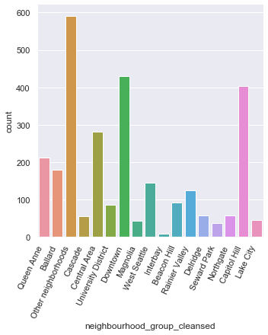
EXPLORATORY DATA ANALYSIS
Notes:
This is also part of the analysis where we breakdown the type of houses, listings and the areas.

Slide 10
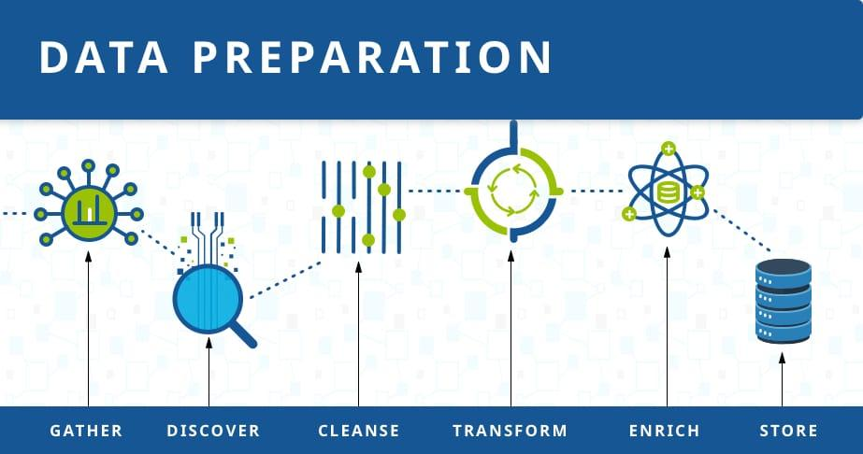
03
PREPARING THE DATASET

Slide 11
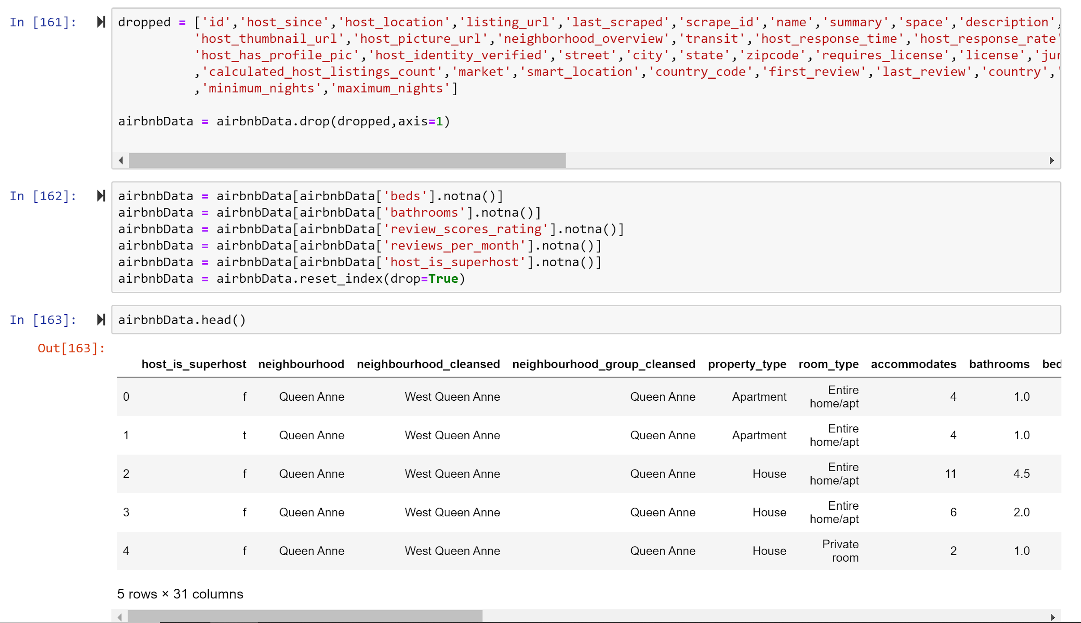
HOW WE PREPARED THE DATA
Notes:
In the first column, we dropped the columns we had no use of
Then, we used .notna() to remove null values for the rows that contained them

Slide 12
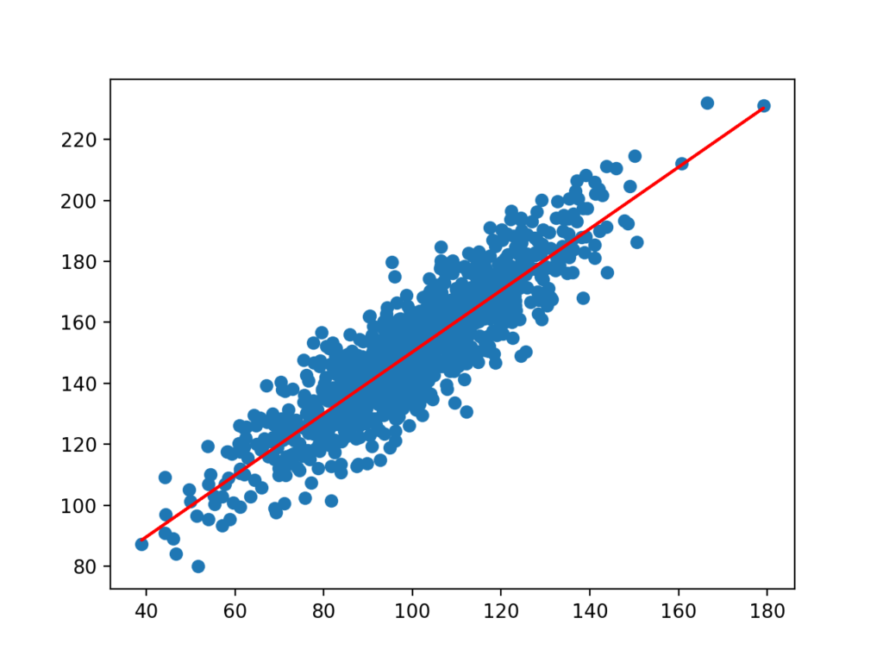
04
LINEAR REGRESSION PREDICTION

Slide 13
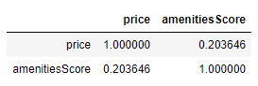
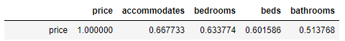
REGRESSION TECHNIQUE
After exploratory analysis, we came up with these regression predictors:
Beds
Bedrooms
Bathrooms
“accommodates” (number of people allowed)
Amenities, but we had to encode it first
Notes:
As above

Slide 14
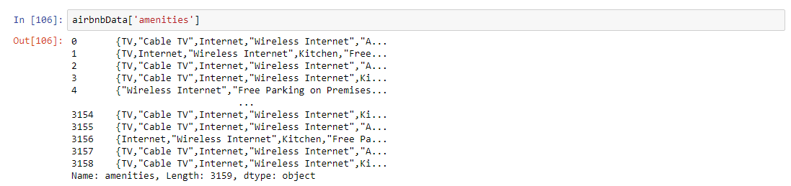
AMENITY ENCODING
When first presented with the data:
Ameneties was a categorical variable
Values were arranged in a string format containing all the different amenities
Messy, unable to derive anything from the data
Notes:
As above

Slide 15
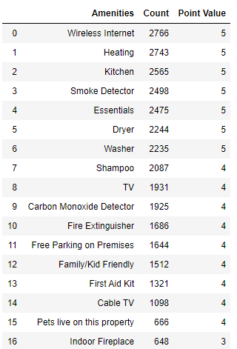
AMENITY ENCODING
We had to find a way to split up the amenities values
Convert each string into a list [“TV, Internet, Washer”]
Split each element in the list [“TV”, “Internet”, “Washer”]
We then decided to encode each amenity with a value
Values are determined by how common the amenities are
Amenities which appeared more often were given higher values
For example, “Wireless Internet” (2766 counts) has a score of 5 while “TV” (1931 counts) has a score of 4
Notes:
As above

Slide 16
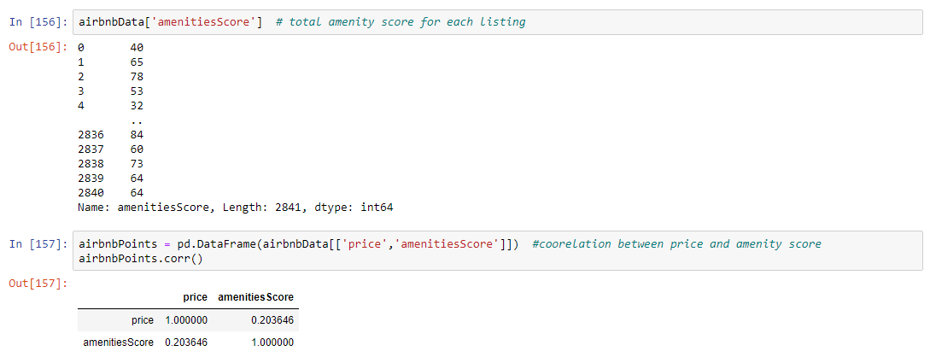
AMENITY ENCODING
Then, each listing has a total amenities score based on the score of the amenities it has
Total score is affected by how many amenities the listing has + whether the listing has more common (and probably important) amenities
This amenities score is used in the regression
Notes:
As above

Slide 17
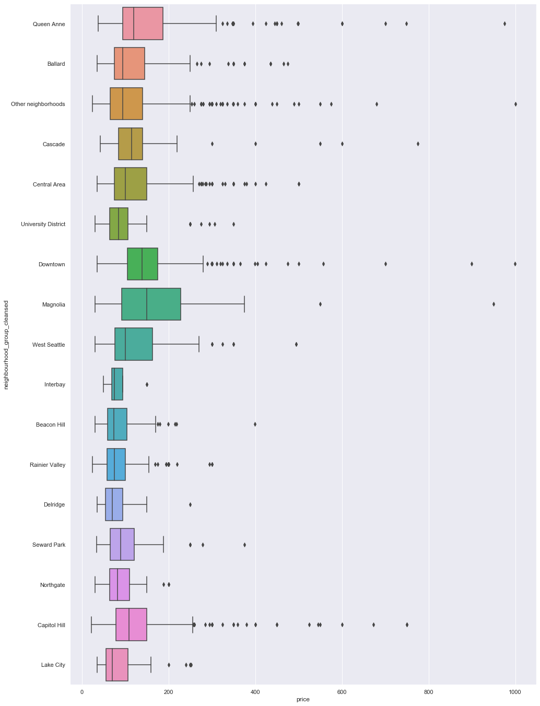
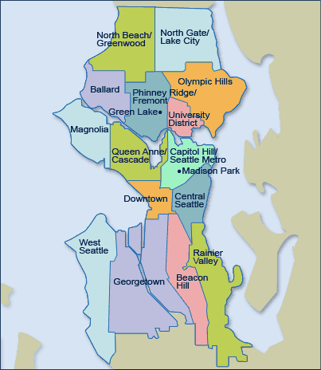
Notes:
Talk about how areas around downtown have higher median prices(e.g. Capitol hill, central area)
But, houses by the bay are also higher in price(e.g. magnolia)
Couldn’t use in regression due to difficulty in encoding

Slide 18
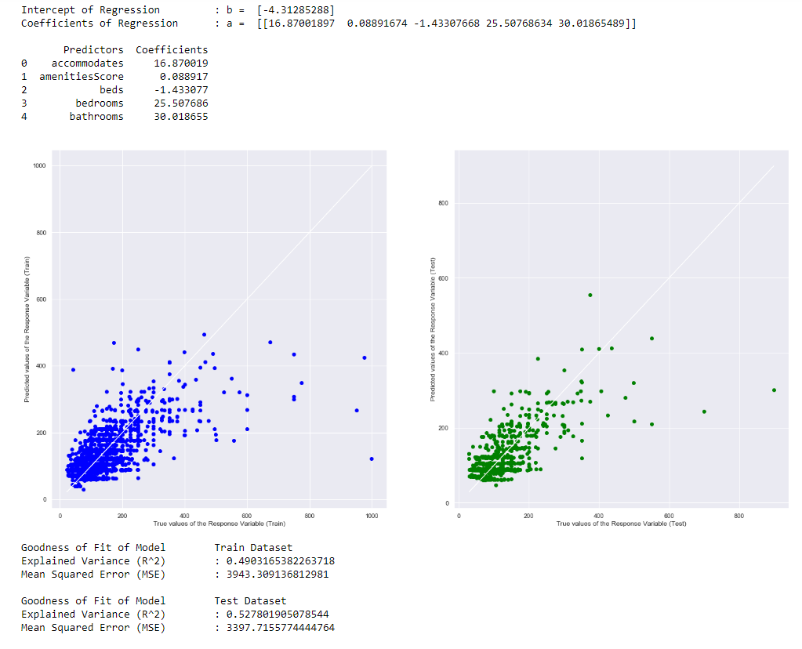
Results of regression
Notes:
Talk about how after the model fitting, we were able to achieve a r^2 of 0.448
Both train and test r^2 is similar, so no over-fitting has occured

Slide 19
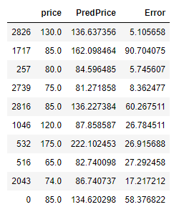
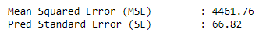
Results of regression
Notes:
On average, the error percent is around 20 percent

Slide 20

05
PREDICTING PRICE USING OTHER TECHNIQUES
Notes:
how we predicted the price of an airbnb listing using other machine learning techniques

Slide 21
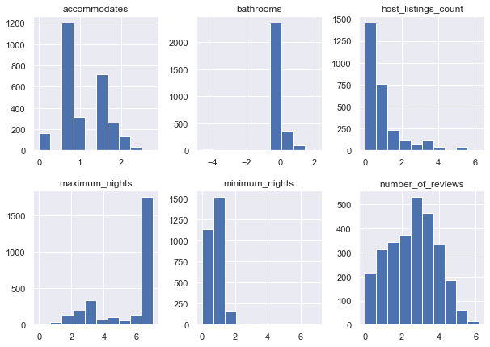
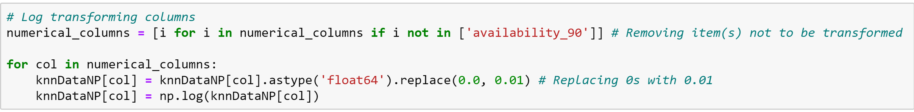
PREPARING DATA FOR PREDICTORS
Numeric data
Log it to have a normal curve
Notes:
Before delving into the techniques, i used the numerical data from our dataset and log transformed it to get a normal curve for the predictors

Slide 22
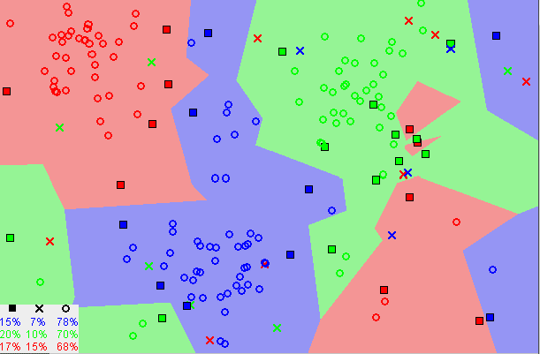
K-Nearest Neighbour (KNN)
Supervised machine learning algorithm
Classification
Regression
Assumes that similar things exist in close proximity
Notes:
FIRSTLY, WE DID THE K-NEAREST NEIGHBOUR ALGORITHM which is a supervised machine learning algorithm that can be used to solve both classification and regression problems.
Which Assumes that similar things exist in close proximity. In other words, similar things are near to each other.
The KNN algorithm hinges on this assumption being true enough for the algorithm to be useful. KNN captures the idea of similarity (sometimes called distance, proximity, or closeness) with some mathematics

Slide 23
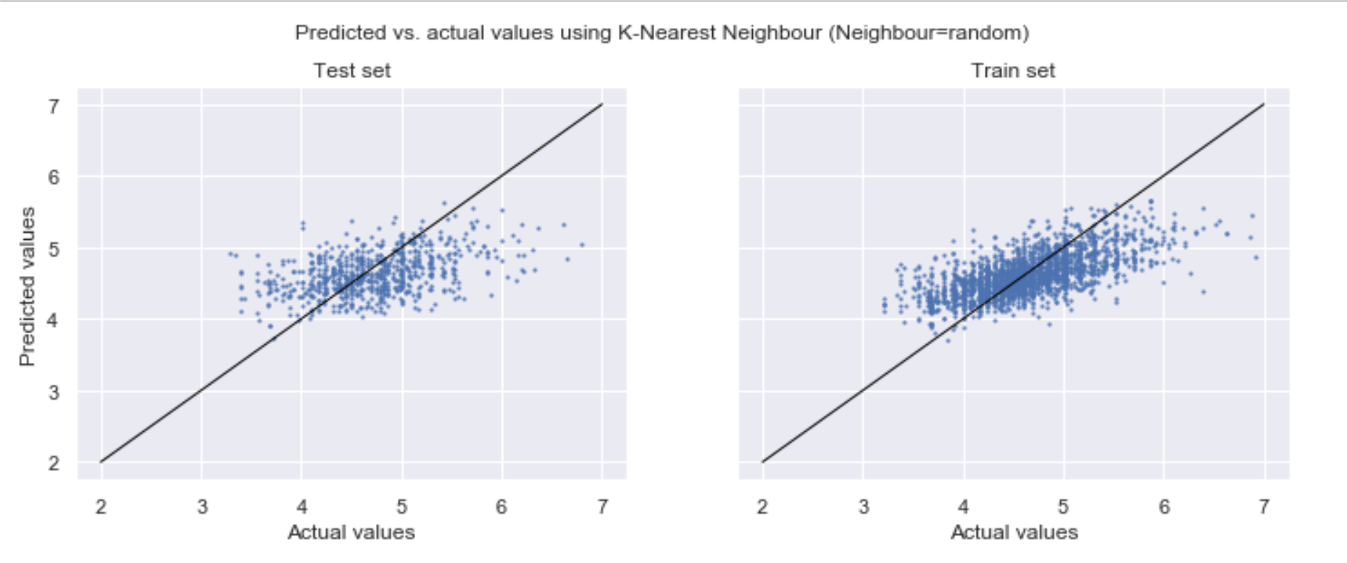
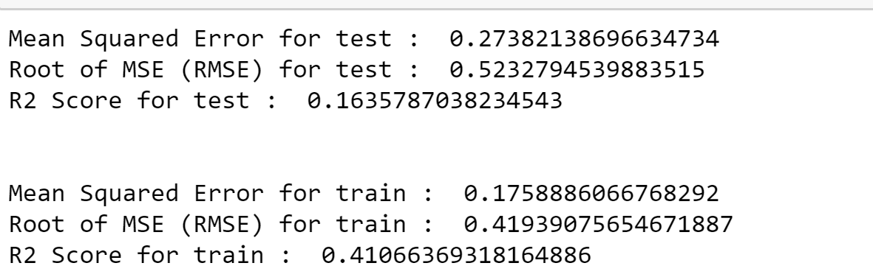
K-Nearest Neighbour (KNN)
Notes:
To compare which machine learning technique will be the most accurate, I will compare the Root Mean Square Error or RMSE for each technique
For our KNN prediction, the RMSE is 0.52 for train and 0.41 for test, which suggests overfitting of the data

Slide 24
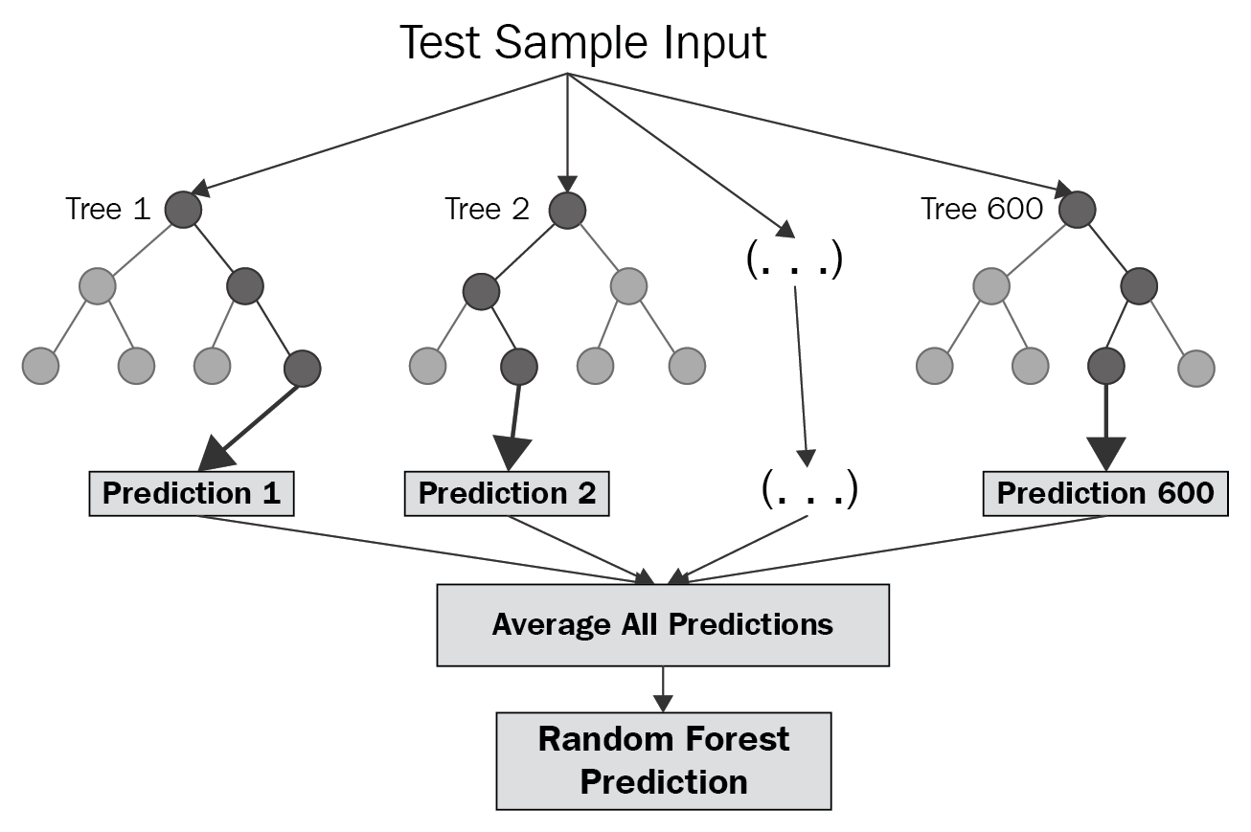
Random Forest Regressor
Ensemble technique capable of performing both regression and classification tasks with the use of multiple decision trees
A more complex and in-depth decision tree
Notes:
The random forest is a model made up of many decision trees. Rather than just simply averaging the prediction of trees (which we could call a “forest”), this model uses two key concepts that gives it the name random:
Random sampling of training data points when building trees
Random subsets of features considered when splitting nodes
When training, each tree in a random forest learns from a random sample of the data points. The samples are drawn with replacement, known as bootstrapping, which means that some samples will be used multiple times in a single tree. The idea is that by training each tree on different samples, although each tree might have high variance with respect to a particular set of the training data, overall, the entire forest will have lower variance but not at the cost of increasing the bias.
At test time, predictions are made by averaging the predictions of each decision tree. This procedure of training each individual learner on different bootstrapped subsets of the data and then averaging the predictions is known as bagging, short for bootstrap aggregating.

Slide 25
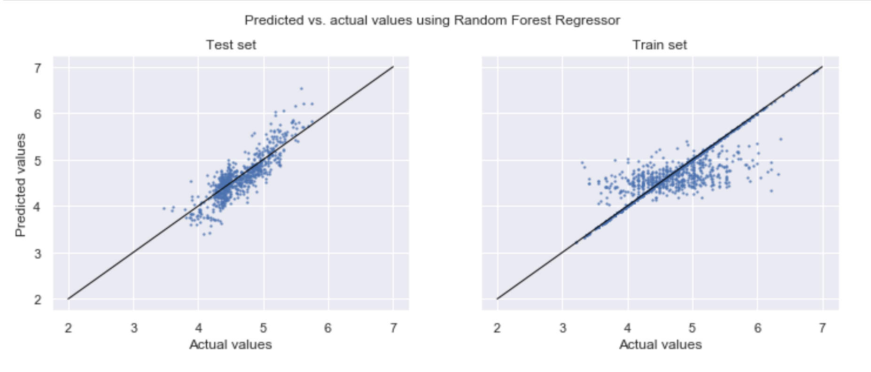
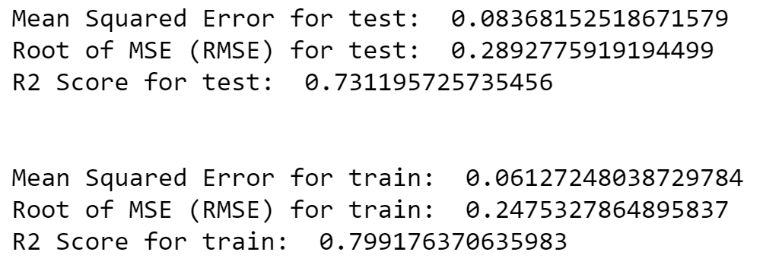
Random Forest Regression
Notes:
For our random forest regression prediction, the RMSE is 0.28 for train and 0.24 for test

Slide 26
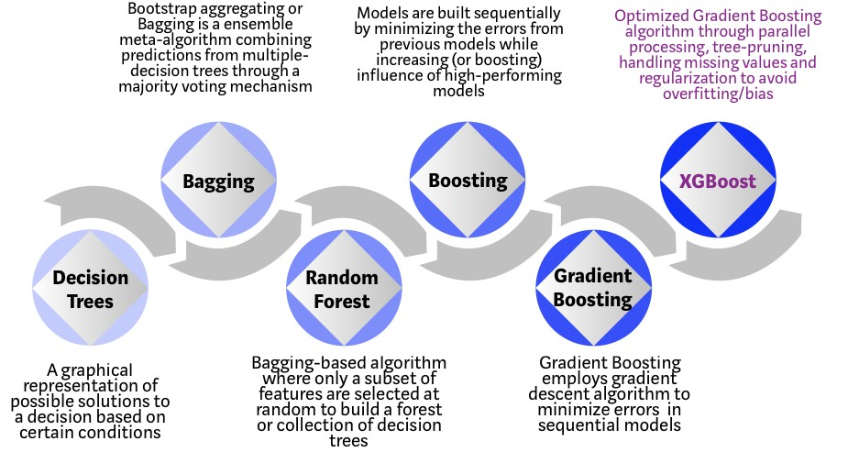
XGBoost Regressor
Another decision tree based Machine Learning Algorithm
Uses a gradient boosting framework
Can be used to solve regression, classification, ranking, and user-defined prediction problems.
Used for deep-learning (neural) network
Notes:
XGBoost is an implementation of gradient boosted decision trees designed for speed and performance.
For our project, we made use of xgboost for our simple neural network algorithm where i will talk about shortly

Slide 27
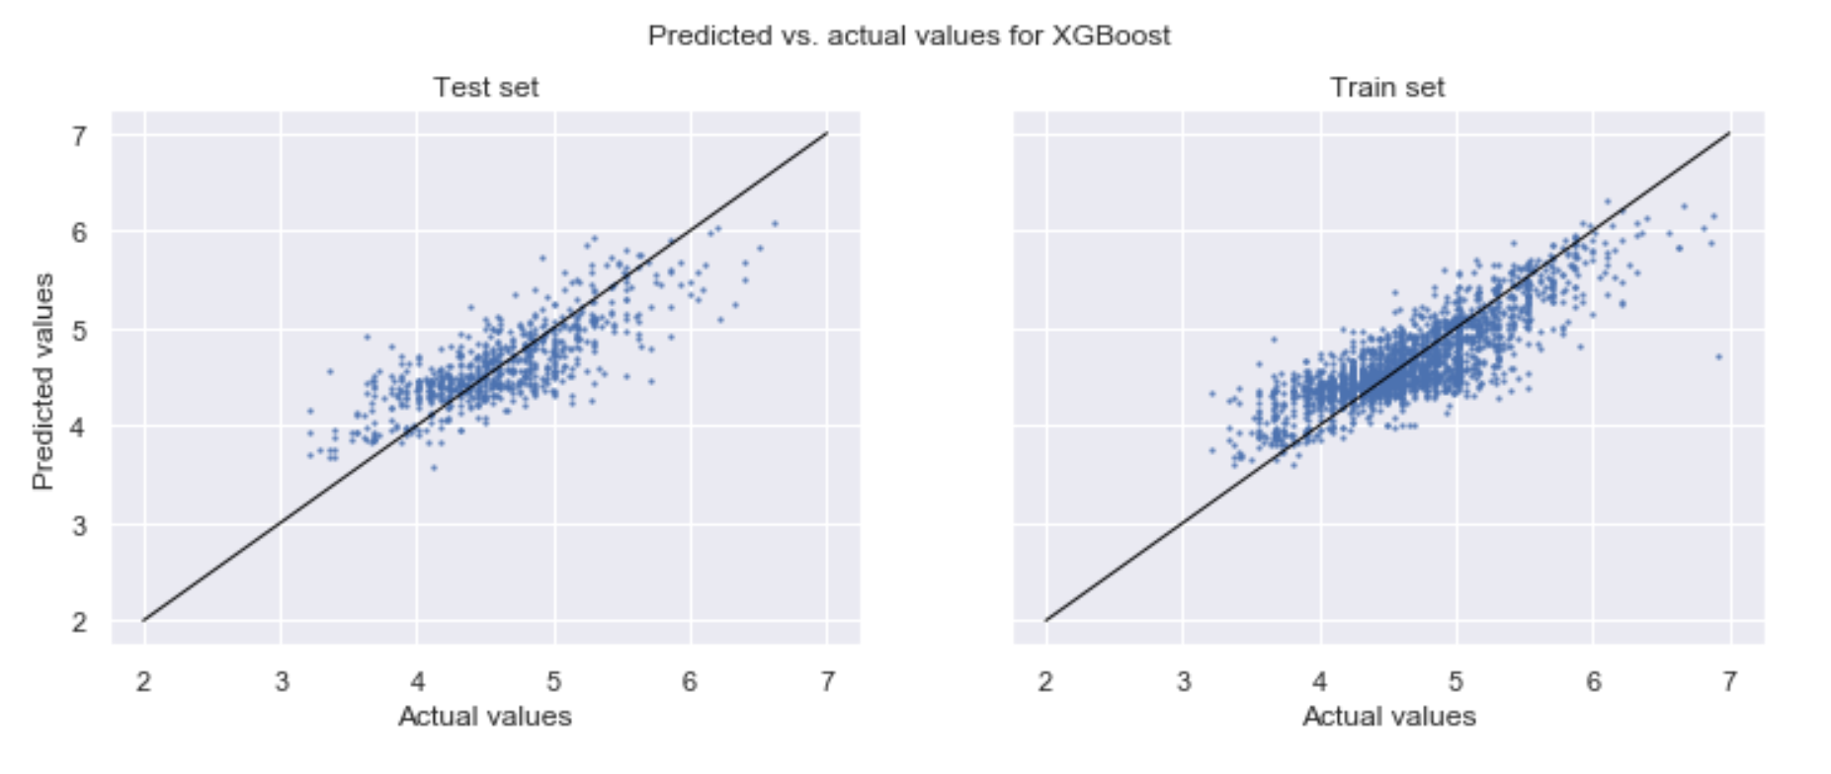
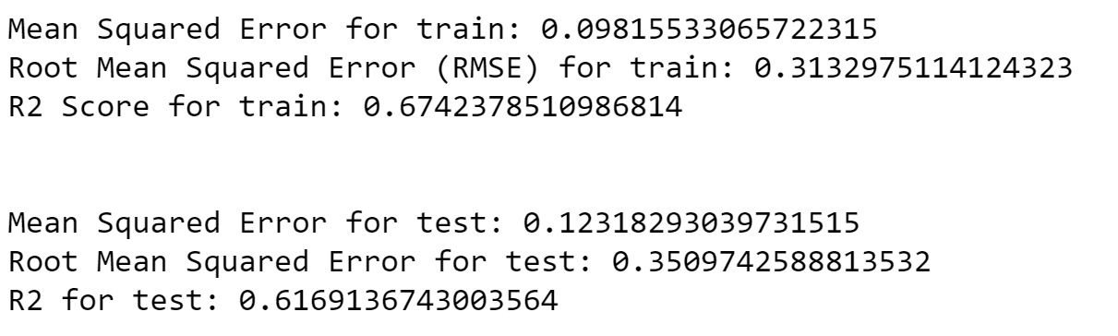
XGBoost Regressor
Notes:
For our xgboost regression prediction, the RMSE is 0.31 for train and 0.35 for test

Slide 28
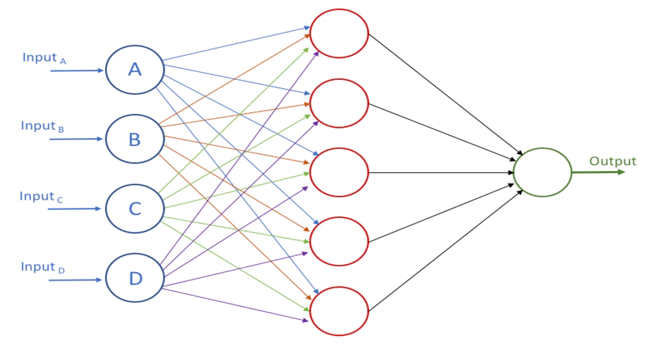
Neural Network
Set of algorithms, modeled loosely after the human brain, that are designed to recognize patterns
Interpret sensory data through a kind of machine perception
Clustering and classification
Notes:
Neural networks are a set of algorithms, modeled loosely after the human brain, that are designed to recognize patterns.
Neural networks help us cluster and classify.
You can think of them as a clustering and classification layer on top of the data you store and manage.

Slide 29
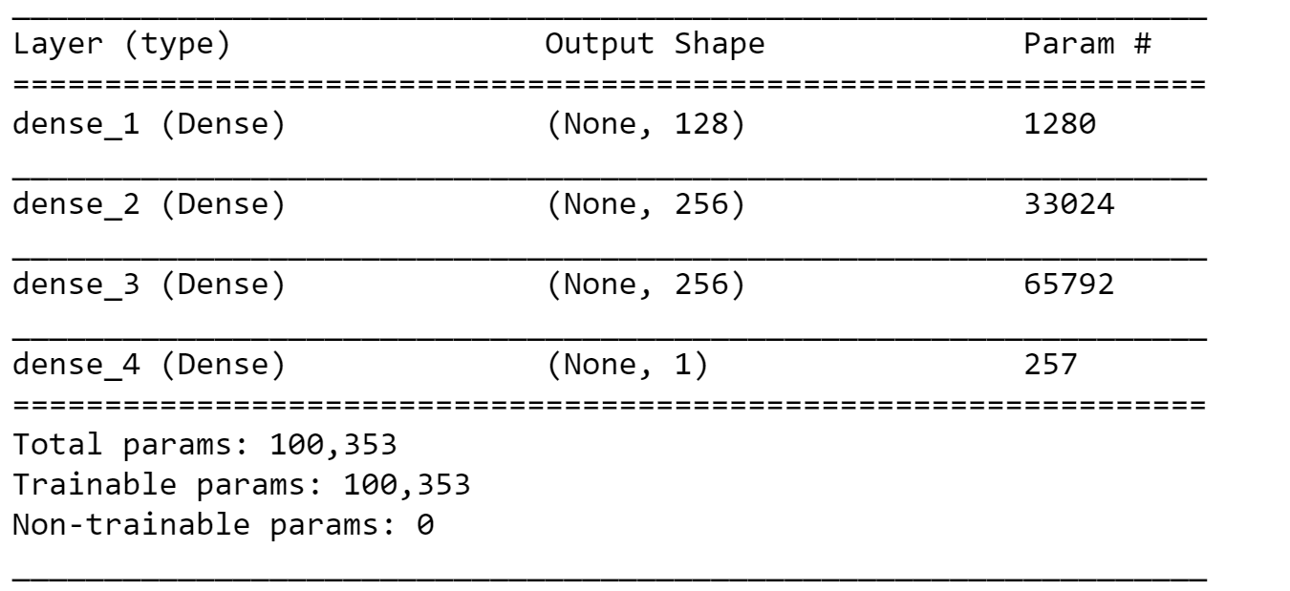
Neural Network
Notes:
For our project, I only did a three-layer nueral network as we feel that is it not necesseary for us to do deep learning

Slide 30
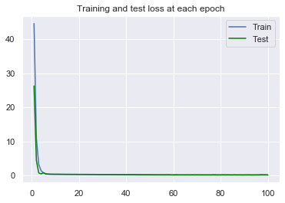
Neural Network
Notes:
For neural networks. the number of epochs (ee-POKS) is related to the number of rounds of optimization that are applied during training. With more rounds of optimization, the error on training data will reduce further and further

Slide 31
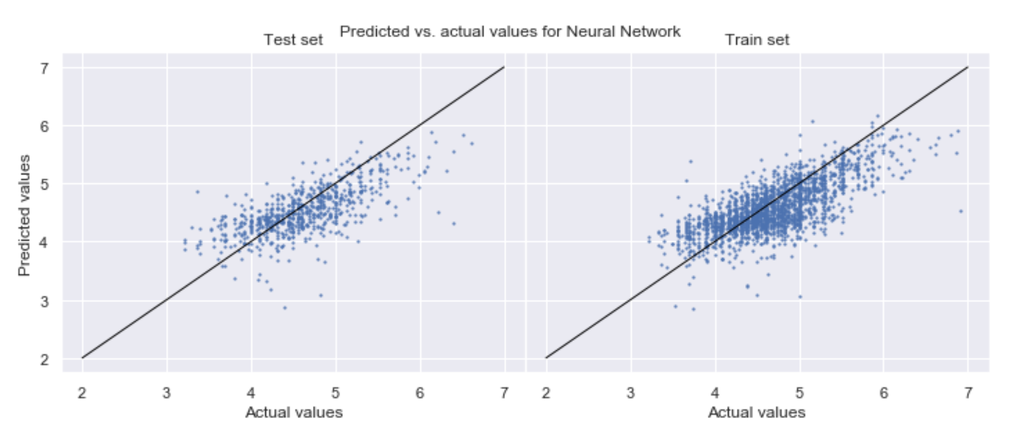
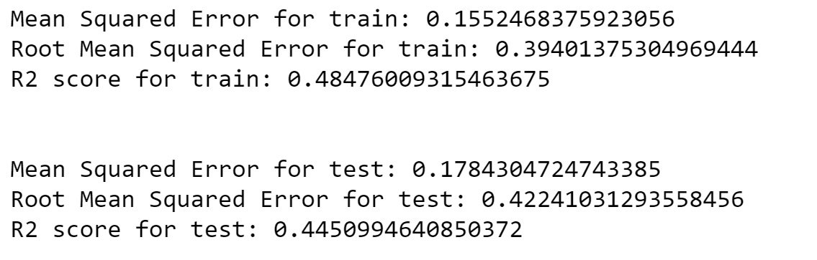
Neural Network
Notes:
For our neural netowrk prediction, the RMSE will be 0.39 for train and 0.42 for test

Slide 32
RANDOM FOREST REGRESSION
PREFERRED MACHINE LEARNING TECHNIQUE:
Notes:
All in all, our preferred machine learning technique will be random forest regression, as the RMSE is the lowest amongst all the prediction and this suggests that it is not necessary to touch on deep learning, even though deep learning is quoted to be the best machine learning technique.

Slide 33

06
TIME SERIES ANALYSIS + PREDICTING THE PRICE USING TIME
Notes:
Hi I am Chocka. I will be sharing about time series analysis

Slide 34
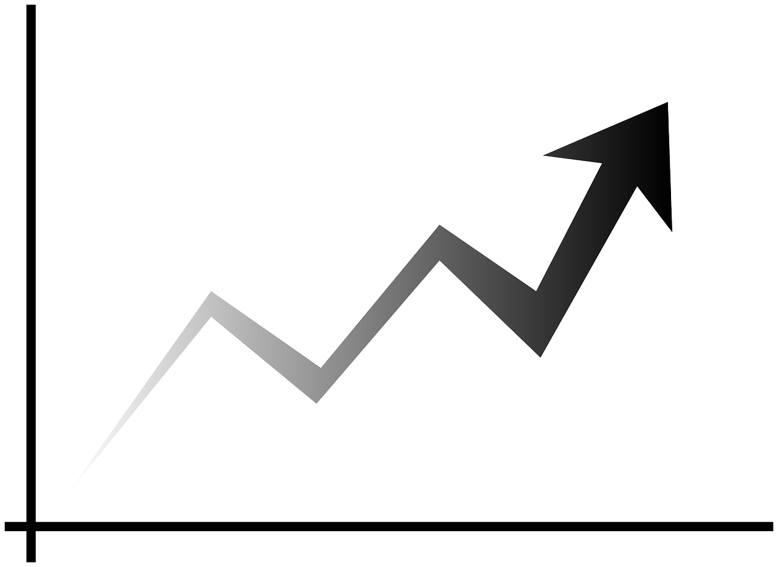

TIME SERIES ANALYSIS
Analysis of previous data at equal intervals to predict future values
Components of a Time Series:
Trend : General tendency of the data to increase or decrease during a long period of time
Seasonality - whether the time series exhibit similar pattern within a month or a year
Irregularity- presence of unpredictable components within the pattern
Cyclic : Pattern showing an up and down movement around a given trend
Notes:
Time series analysis would be learning from past data to predict future values. There are 4 components in a time series which is tren, seasonality,Irregularity and cyclic pattern

Slide 35
Stationarity
ARIMA
Autoregressive Integrated Moving Average Model to build TS Graph
A Stationarity Series is one whose mean, variance and autocovariance are constant over time.
Test to check for Stationarity:
Rolling Statistics: Moving Average and Moving variance over time
ADCF (Augmented Dickey Fuller ) Test:
Input Data
Auto regressive (P)
ARIMA Model
Time Series Forecast
Order of Differentiation (d)
Moving Average (Q)
Notes:
Before we build the model, we must ensure our data achieves stationarity which means that the series does not change over time. It has constant Mean, Variance and Autocovariance. In order to check the Stationarity, we have to find rolling statistics such as moving average and moving variance. Then we can also use a ADCF test Augumented Dicky Fuller Test.
Once done we will use ARIMA ( Autoregressive Integrated Moving average Model) to do the prediction which consists of Auto regressive, order of differentiation and the moving average.

Slide 36
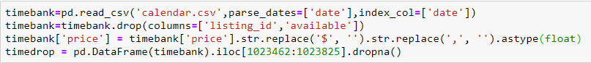
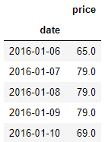
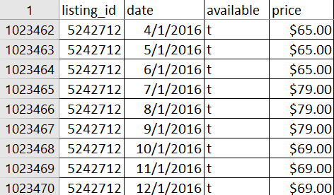
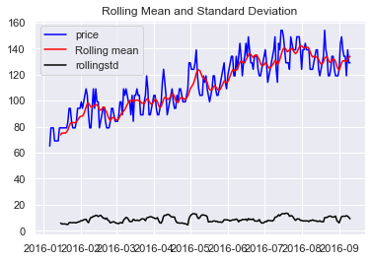
Preparing Data
Calendar.csv
Problem Statement : Build a forecast for the price of Airbnb for the next 30 days using past data
timedrop_logScale=np.log(timedrop)
Notes:
We will be using the calendar.csv file
We will prepare the data set by removing the columns other than date and price columns.
The graph at the bottom shows the change in price over 230 days from January to September. The red value represents the rolling mean average and the black line shows the rolling standard deviation. This graph is not suitable as the rolling mean is not constant.

Slide 37
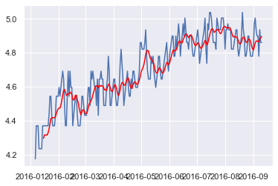
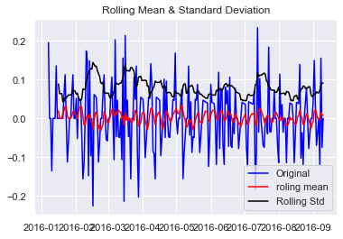
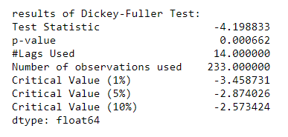
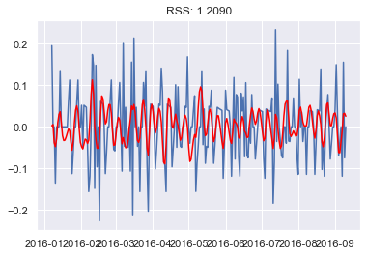
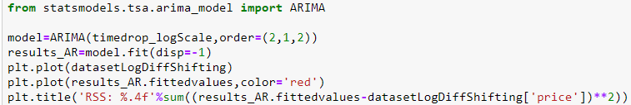
datasetLogDiffShifting=timedrop_logScale - timedrop_logScale.shift()
Notes:
I manipulated the data to achieve a graph with constant mean. From the dickey fuller test our p value is less than 0.05 which means that our data is now stationary. Once done we import the model Arima to calculate the residual sum of squares . The closer to 1 the better the RSS value. Our value is 1.2 which is good and is suitable to carry out our predictions

Slide 38
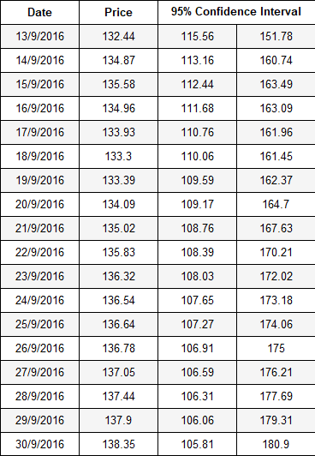
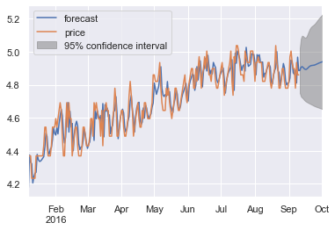
results_ARIMA.plot_predict(1,270)
x=results_ARIMA.forecast(steps=30)
Notes:
We are then able to predict the values for the next 30 days of the data and also generate a 95% confidence interval which means that the prices won’t exceed the range. Hence the price on 13 September 2016 would be 132.44 for this AirBnb Unit

Slide 39

07
PREDICTION OF SUPERHOST STATUS
Notes:
we also did the prediction of superhost status

Slide 40

WHAT IS AN AIRBNB SUPERHOST
Superhosts are experienced hosts who provide a shining example for other hosts
Being a Superhost gets you more money
Notes:
So, what is an airbnb superhost?
Superhosts are basically experienced hosts who provide a shining example for other hosts.
So becoming a superhost on airbnb will likely to get you more money as compared to a regular host

Slide 41
SELECTED CATEGORIES FOR THE PREDICTORS
Review scores rating:
The overall rating (by percentage) of a host
Host response rate:
number of inquiries to which a host has responded to within 24 hours divided by the total number of inquiries a host has received in the past 90 days
Host listings count:
The number of Airbnb listings the host has
Reviews per month
The average number of reviews per month of an Airbnb listing
Number of reviews:
Total number of reviews of an Airbnb listing
Price:
Price of an AirBnb listing
Notes:
Moving on, we had to select the relevant categories to predict the superhost status.
The ones we picked are: review scores rating, host response rate, host listings count, reviews per month, number of reviews and price(see from slides)

Slide 42
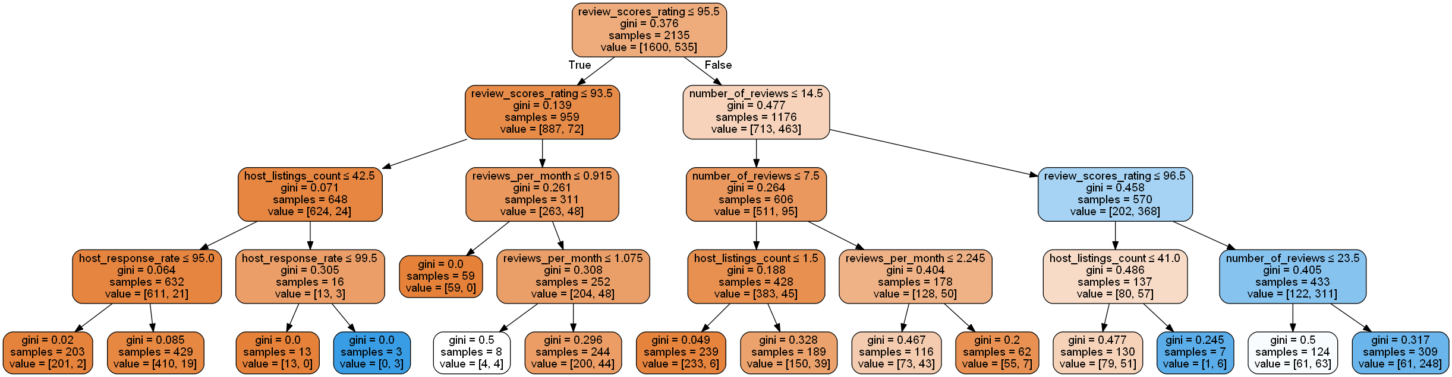
SATURN
Notes:
Firstly, we did multivariate classification to determetine the classifcation accuracy for our predcition (but in our project we did univariate classification for all of the predcitors)

Slide 43
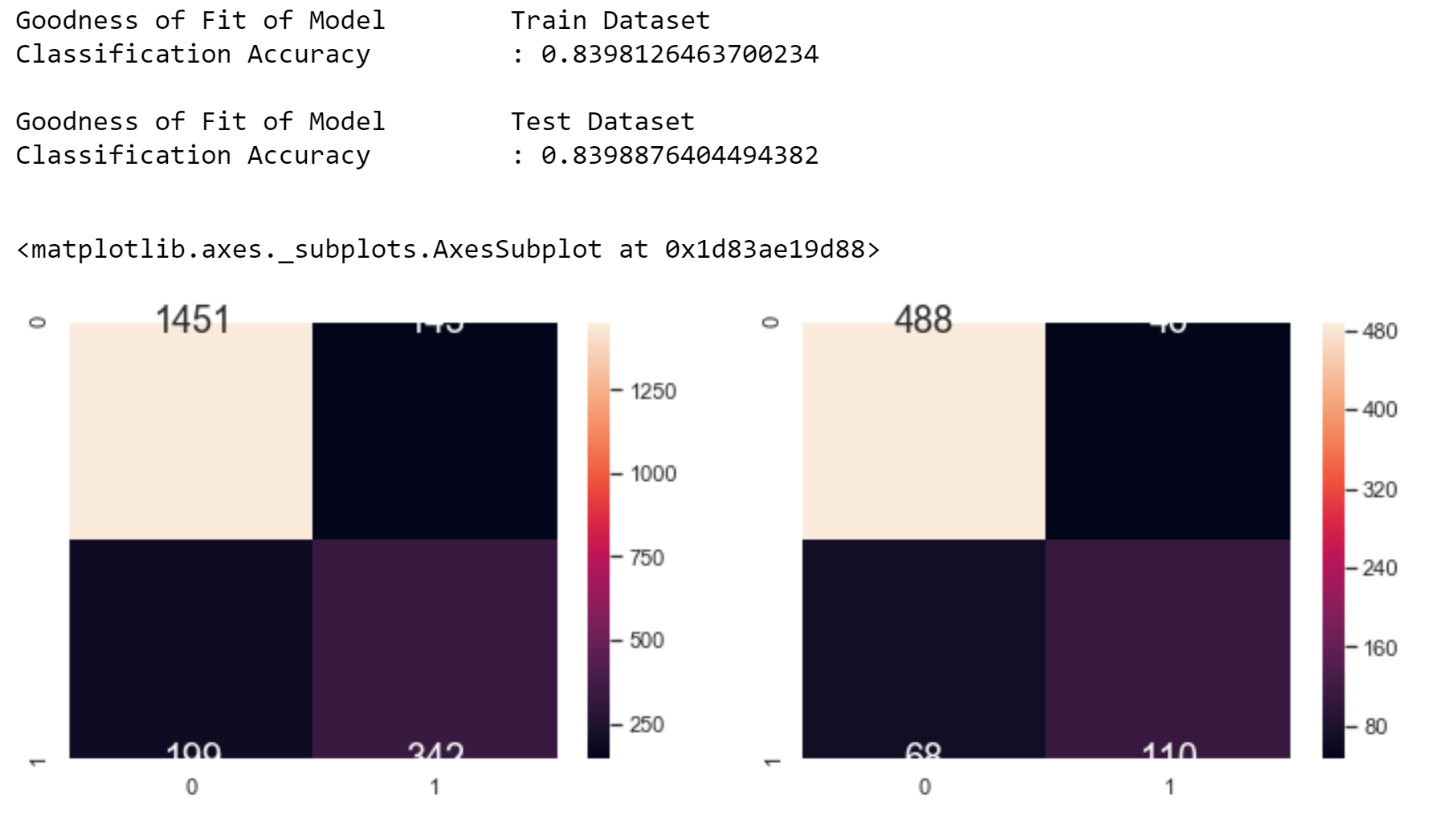
CLASSIFICATION ACCURACY FOR ALL THE CATEGORIES
SATURN
Notes:
After doing the multivariate classification tree, we saw that the goodnes fit of model is quite high (albeit not more than 90%) but it is suffiiceint for our dataset

Slide 44
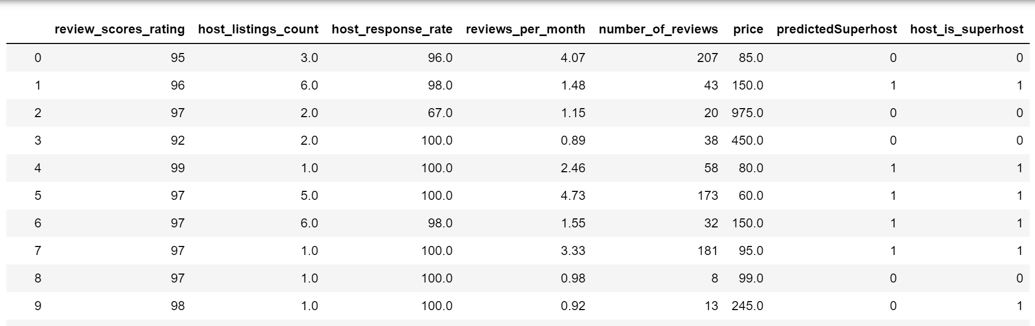
PREDICTING SUPERHOST STATUS
Notes:
And finally, as you can see, the prediction of the superhost status is quite accurate in a sense that in this screengrab out of a sample of 9, there’s only ONE account with a false positive reading.
I will now pass on my time to ting qi who will end off our presentation

Slide 45

08
CONCLUSION

Slide 46
Conclusion
The regression models uses logical variables to help predict pricing.
Encoding of amenities allows us to use categorical variables in the regression models.
Neighbourhood analysis allows a host to see which area is more profitable than others.
Time Series Analysis allows hosts to change the prices by learning from data from past months to maximise their profit.
Super-host classification helps hosts predict their chances of becoming one, thus allowing for higher revenue.
All of these machine learning solutions ties back to our problem of helping hosts to maximise their revenue

Slide 47
Credits
Ting Qi - Debugging and did Machine Learning for Superhost
Jaryl - Encoding of amenities and Linear Regression
Chocka - Time series Analysis to forecast Airbnb Prices and debugging
Nazhura - Additional regressions, neural network and Superhost prediction

Slide 48
THANK YOU

